Slide 1




DIGITAL LITERACY
SKILLS
ADVANCED USERS

Slide 2
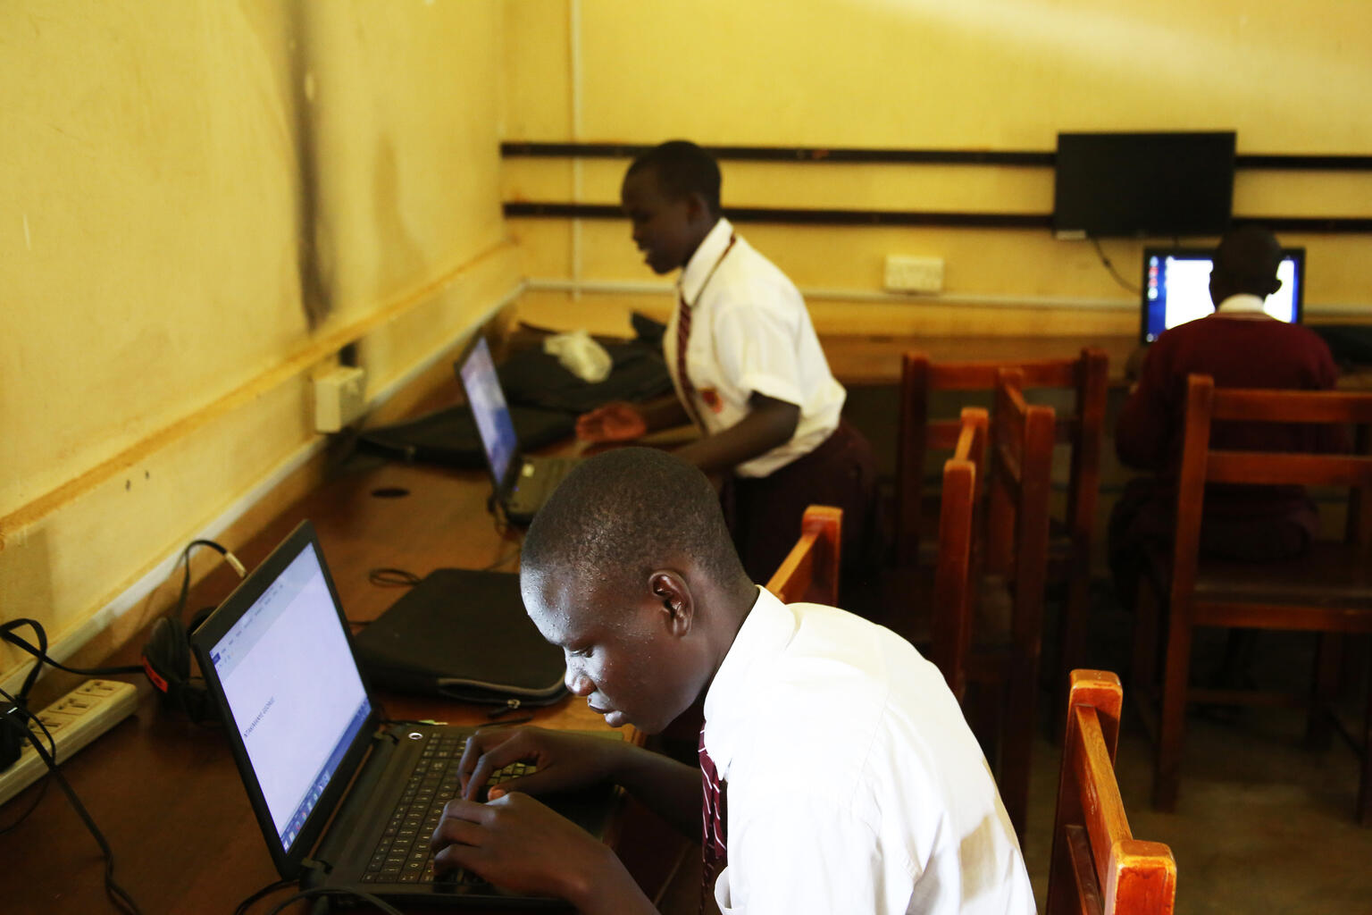
Module 6
Problem solving

Slide 3

2
Unit 2: Identifying needs and technological responses

Slide 4
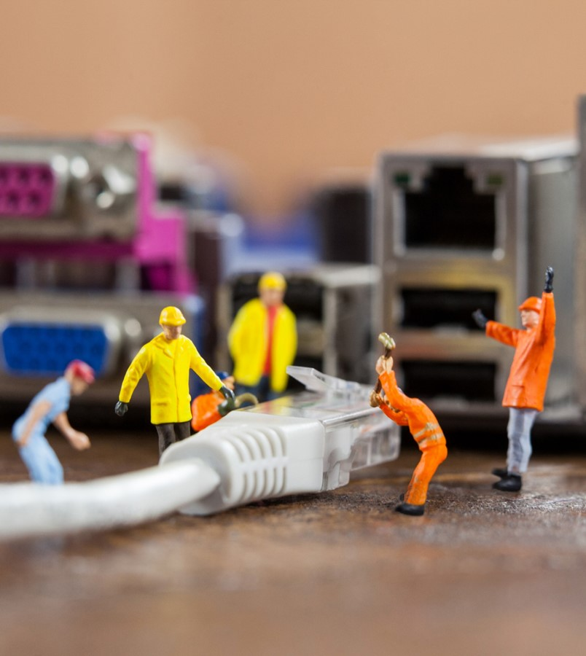
Needs and technological responses
Follow these steps:
Write down your steps.
Take notes about error messages.
Always check the cables.
Restart the computer.
Using the process of elimination.
Use online sources.
Research on the Internet
Online sources

Slide 5

Examples of software
File extensions: are a way of labelling the names of files.
Update software: include patches to fix issues that have been found with earlier versions.
Antivirus software: protects your computer against computer viruses and cybercriminals
Display setting: can be customized to suit your needs.

Slide 6
Skills to practise
Choose tools to solve problems
Use the lists that you created for Unit 1 and to each item on your list, add the tool, application, software, or service that you will use to solve the problem.

Slide 7
All back covers should include
contact information of the section
producing the work.
© United Nations Children’s Fund (UNICEF) [month and year of publication]

